Slide 1
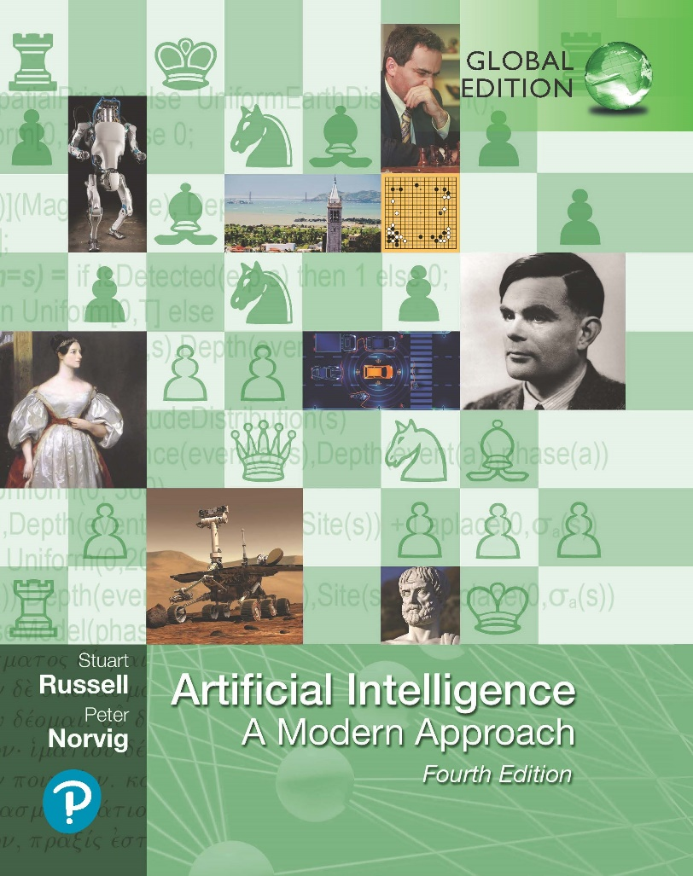
Search in Complex Environments
Artificial Intelligence: A Modern Approach
Fourth Edition, Global Edition
Chapter 4
© 2022 Pearson Education Ltd.

Slide 2
Outline
Local Search and Optimization Problems
Hill-climbing
Simulated annealing
Genetic algorithms
Local search in continuous spaces
Search with Nondeterministic Actions
Search in Partially Observable Environments
© 2022 Pearson Education Ltd.

Slide 3
Local Search and Optimization Problems
In many optimization problems, path is irrelevant; the goal state itself is the solution
Then state space = set of “complete” configurations; find optimal configuration, e.g., TSP
or, find configuration satisfying constraints, e.g., timetable
In such cases, one can use iterative improvement algorithms; keep a single “current” state, try to improve it
Local search algorithms operate by searching from a start state to neighboring states, without keeping track of the paths, nor the set of states that have been reached.
They are not systematic—they might never explore a portion of the search space where a solution actually resides.
© 2022 Pearson Education Ltd.

Slide 4








Example: Travelling Salesperson Problem
Start with any complete tour, perform pairwise exchanges
Variants of this approach get within 1% of optimal very quickly with thou- sands of cities
© 2022 Pearson Education Ltd.

Slide 5











Example: n-queens
Put n queens on an n × n board with no two queens on the same row, column, or diagonal
Move a queen to reduce number of conflicts
h = 5 h = 2
Almost always solves n-queens problems almost instantaneously for very large n, e.g., n = 1million
h = 0
© 2022 Pearson Education Ltd.

Slide 6
Hill-climbing (or gradient ascent/descent)
“Like climbing Everest in thick fog with amnesia”
function Hill-Climbing( problem) returns a state that is a local maximum
inputs: problem, a problem
local variables: current, a node
neighbor, a node
current ← Make-Node(Initial-State[problem])
loop do
neighbor ← a highest-valued successor of current
if Value[neighbor] ≤ Value[current] then return State[current]
current ← neighbor
end
© 2022 Pearson Education Ltd.

Slide 7


Hill-climbing contd.
Useful to consider state space landscape
objective function
global maximum
shoulder
local maximum
"flat" local maximum
current state
state space
Random-restart hill climbing overcomes local maxima—trivially complete
Random sideways moves escape from shoulders loop on flat maxima
© 2022 Pearson Education Ltd.

Slide 8
Simulated annealing
Idea: escape local maxima by allowing some “bad” moves
but gradually decrease their size and frequency
function Simulated-Annealing( problem, schedule) returns a solution state
inputs: problem, a problem
schedule, a mapping from time to “temperature”
local variables: current, a node
next, a node
T, a “temperature” controlling prob. of downward steps
current ← Make-Node(Initial-State[problem])
for t ← 1 to ∞ do
T ← schedule[t]
if T = 0 then return current
next ← a randomly selected successor of current
∆E ← Value[next] – Value[current]
if ∆E > 0 then current ← next
else current ← next only with probability e^{∆ E/T}
© 2022 Pearson Education Ltd.

Slide 9
Properties of simulated annealing
At fixed “temperature” T , state occupation probability reaches Boltzman distribution
E(x)
p(x) = αe ^{kT}
T decreased slowly enough =⇒ always reach best state x∗
* ∗
E(x ) E(x)
E(x )−E(x)
because e /e = e � 1 for small T
kT kT kT
Is this necessarily an interesting guarantee??
Devised by Metropolis et al., 1953, for physical process modelling Widely used in VLSI layout, airline scheduling, etc.
© 2022 Pearson Education Ltd.

Slide 10
Local beam search
Idea: keep k states instead of 1; choose top k of all their successors
Not the same as k searches run in parallel!
Searches that find good states recruit other searches to join them
Problem: quite often, all k states end up on same local hill Idea: choose k successors randomly, biased towards good ones Observe the close analogy to natural selection!
© 2022 Pearson Education Ltd.

Slide 11
Genetic algorithms
= stochastic local beam search + generate successors from pairs of states
24748552
24
31%
3275
2411
3274
8552
32748152
32752411
23
29%
24748552
2475
2411
24752411
24415124
20
26%
327524
11
327521
24
32252124
32543213
11
14%
24415124
244154
11
24415417
Fitness
Selection
Pairs
Cross−Over
Mutation
© 2022 Pearson Education Ltd.

Slide 12























Genetic algorithms contd.
GAs require states encoded as strings (GPs use programs)
Crossover helps iff substrings are meaningful components
+
=
GAs /= evolution: e.g., real genes encode replication machinery!
© 2022 Pearson Education Ltd.

Slide 13
Continuous state spaces
Suppose we want to site three airports in Romania:
6-D state space defined by (x₁, y₂), (x₂, y₂), (x₃, y₃)
objective function f (x₁, y₂, x₂, y₂, x₃, y₃) =
sum of squared distances from each city to nearest airport
Discretization methods turn continuous space into discrete space, e.g., empirical gradient considers ±δ change in each coordinate
Gradient methods compute

∂f ∂f ∂f ∂f ∂f ∂f

∇f =

, , , , ,




∂x ∂y₁ ∂x₂ ∂y₂ ∂x₃ ∂y

1 3
to increase/reduce f , e.g., by x ← x + α∇f (x)
Sometimes can solve for ∇f (x) = 0 exactly (e.g., with one city). Newton–Raphson (1664, 1690) iterates x ← x − H⁻_{f} ¹(x)∇f (x) to solve ∇f (x) = 0, where H_{ij} = ∂²f/∂x_{i}∂x_{j}
© 2022 Pearson Education Ltd.

Slide 14
Search with Nondeterministic Actions
Agent doesn’t know the state its transitioned to after action, the environment is nondeterministic.
Rather, it will know the possible states it will be in, which is called “belief state”
Examples:
The erratic vacuum world (if-then-else) steps. If statement tests to know the current state.
AND-OR search trees. Two possible actions (OR nodes). Branching that happens from a choice (AND nodes).
Try, try again. A cyclic plan where minimum condition (every leaf = goal state & reachable from other points in the plan)
© 2022 Pearson Education Ltd.

Slide 15
Search in Partially Observable Environments
Problem of partial observability, where the agent’s percepts are not enough to pin down the exact state.
Searching with no observation: Agent’s percepts provide no information at all, sensorless problem (or a conformant problem).
Solution: sequence of actions, not a conditional plan
Searching in partially observable environments requires a function that monitors or estimates the environment to maintain the belief state.
© 2022 Pearson Education Ltd.

Slide 16
Summary
Local search methods keep only a small number of states in memory that are useful for optimization.
In nondeterministic environments, agents can apply AND–OR search to generate contingency plans that reach the goal regardless of which outcomes occur during execution.
Belief-state is the set of possible states that the agent is in for partially observable environments.
Standard search algorithms can be applied directly to belief-state space to solve sensorless problems.
© 2022 Pearson Education Ltd.

